Slide 1
Lending Club analysis
By Sandeep Kumar

Slide 2
Project Overview
Lending Club:
Lending Club Offer loan to customers. Interest is variable based of factors like term, amount, Grade etc.
Reducing financial loss by analysing past data of defaulter vs normal customer for trends and factors affecting defaulters.
Data Source : Lendingclub.com
Business Constrains
1. If the applicant is likely to repay the loan, then not approving the loan results in a loss of business to the company
2. If the applicant is not likely to repay the loan, i.e. he/she is likely to default, then approving the loan may lead to a financial loss for the company
Business Objective
The aim is to identify patterns which indicate if a person is likely to default, which may be used for taking actions such as denying the loan, reducing the amount of loan, lending (to risky applicants) at a higher interest rate, etc.

Slide 3
Data Cleaning
Data Cleaning and Preparation
Deleting null or missing values or column with same values
outlier treatment, standardizing data, date formatting etc
Univariate Data Analysis for loan defaulters vs fully paid w.r.t all columns features
Plotting graph and stats for each column one at time
Estimating effects of features on loan status by observing
Segmented univariate analysis w.r.t charged off or fully paid loan status
Plotting correlation and scatter w.r.t loan status and income
Deducing conclusions based on observed trends
Bivariate analysis
Inferring risks of defaulters by feature like date, annual income, enquires, state, interested rate etc.

Slide 4
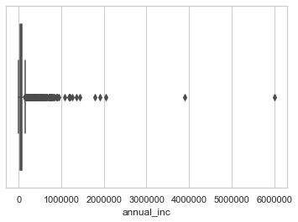
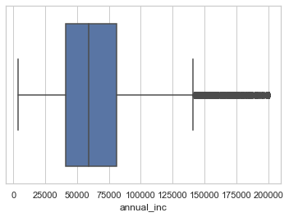
Lets look at annual income
Before outlier treatment
After outlier treatment

Slide 5
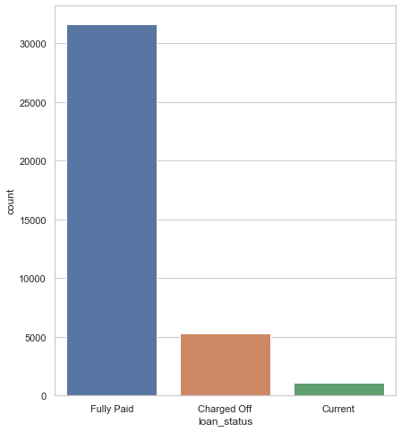
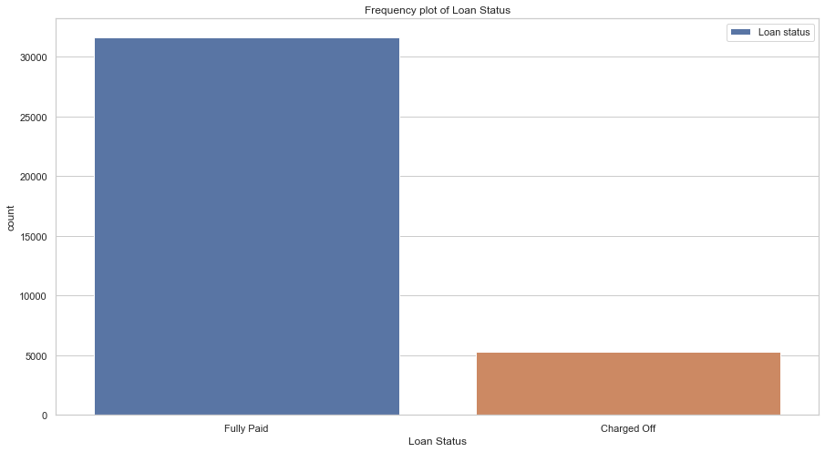
Loan status preparation
excluding current loan status
Raw data

Slide 6
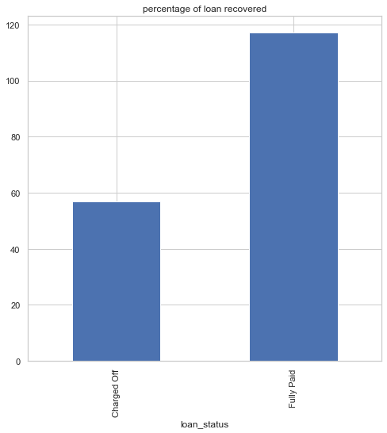
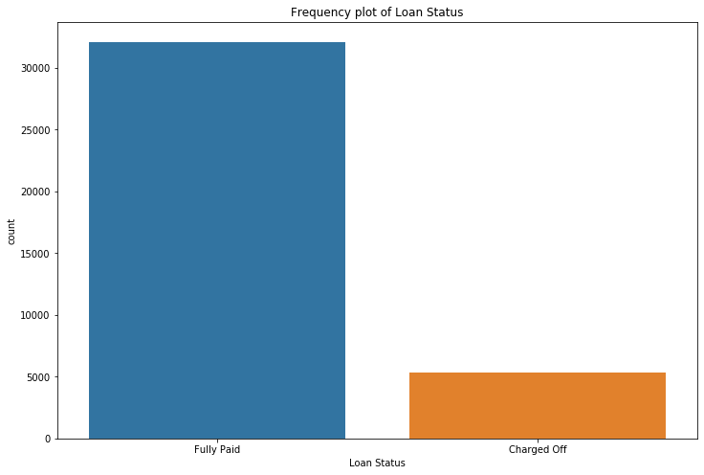
14.2% of people were charged off with 8.9% of total loaned amount
Frequency
Percentage of amount

Slide 7
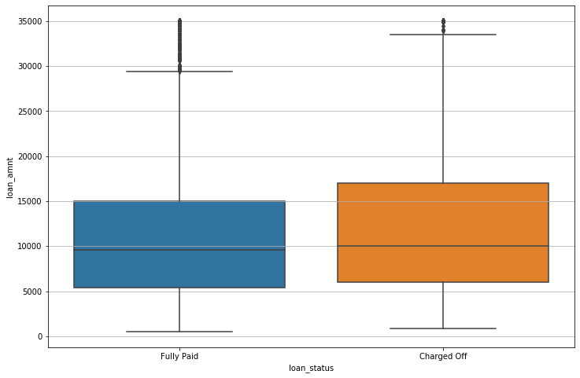
10k loan amount requested more it seems there

Slide 8
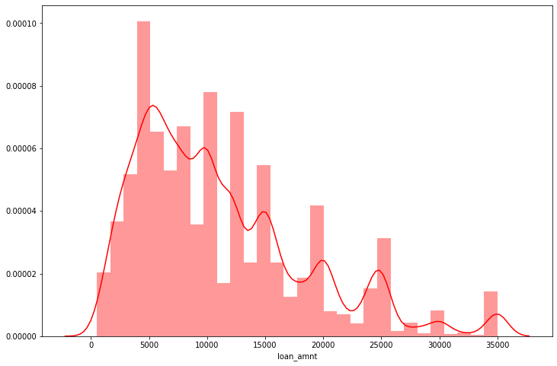
For Standard loan amount of 5,10,15,20,25.. Demand amount is inversely proportional to charged off money

Slide 9
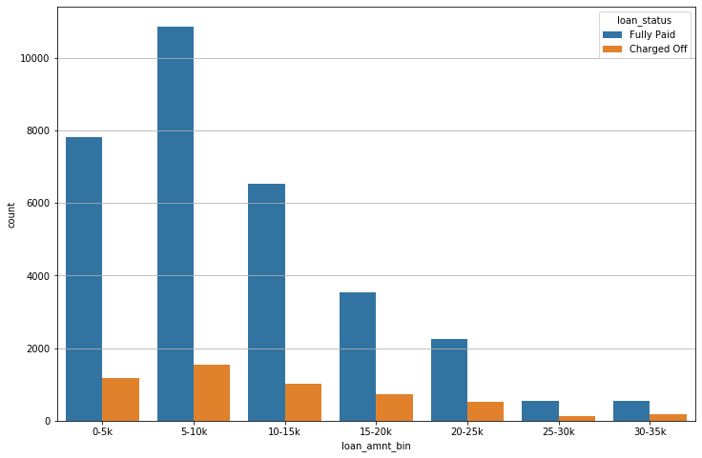
More Demand for lower loan amounts

Slide 10
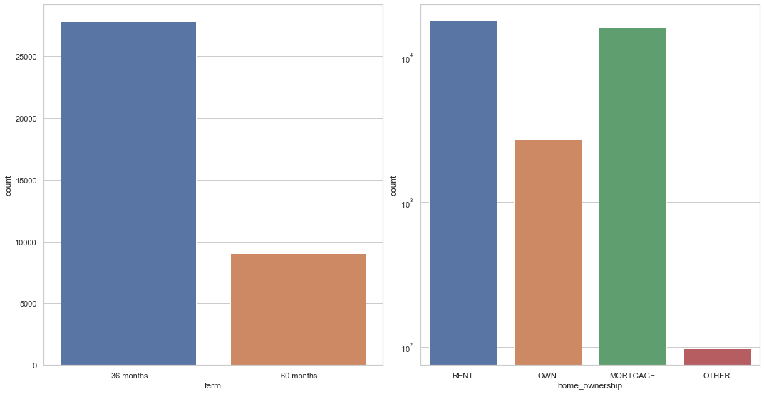
More Demand for 36 month slab by mainly for borrower living on rent and mortgaged homes

Slide 11
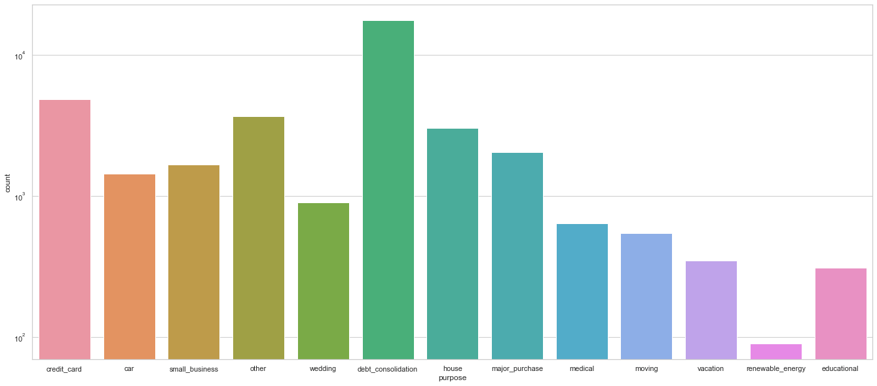
Loan Purpose

Slide 12
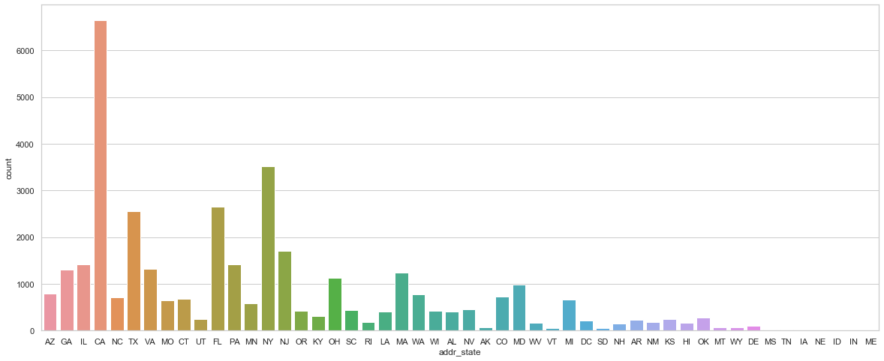
State wise - CA>NY>FL>TX

Slide 13
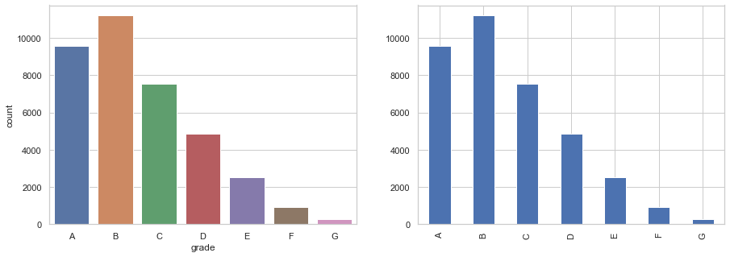
Grade wise loan – A and B are more safe

Slide 14
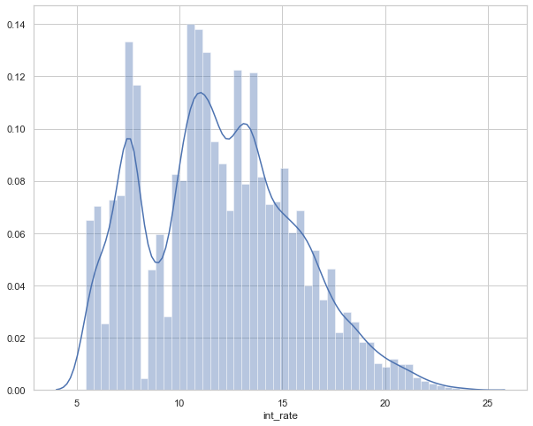
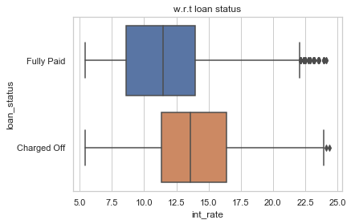
frequent interest rate are from 7 to 14 percent

Slide 15
the more interest rate applied has more tendency to default.

Slide 16
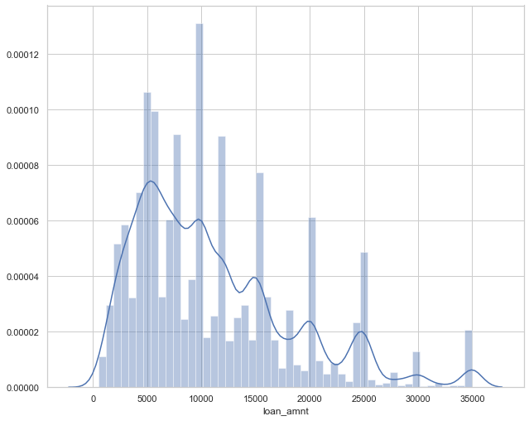
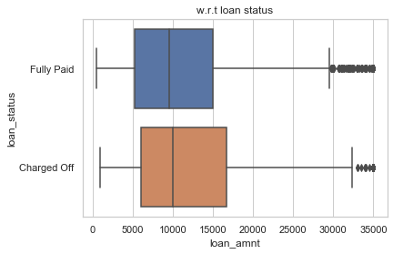
Bigger Loan amount has more tendency to default

Slide 17
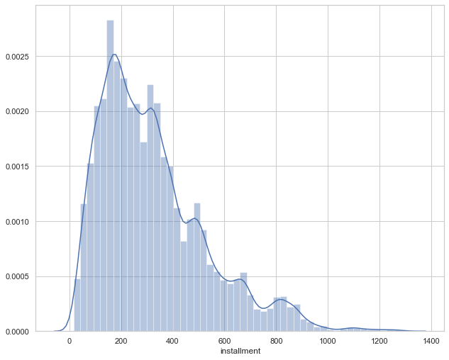
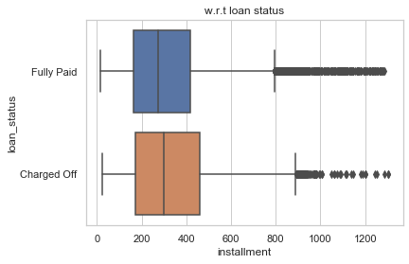
Installment amount

Slide 18
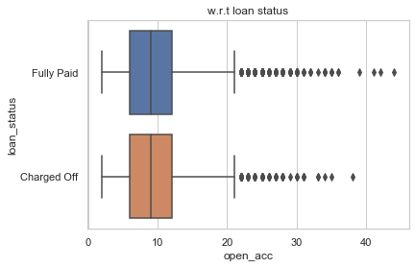
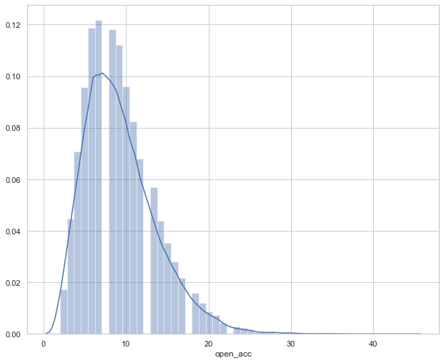
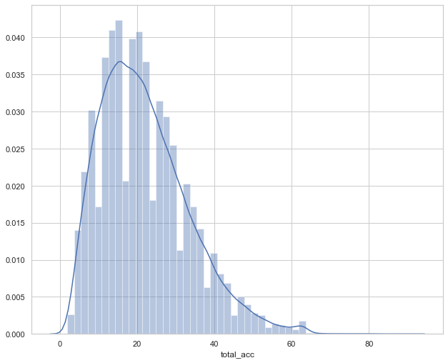
total
Avg credit lines is 22
open

Slide 19
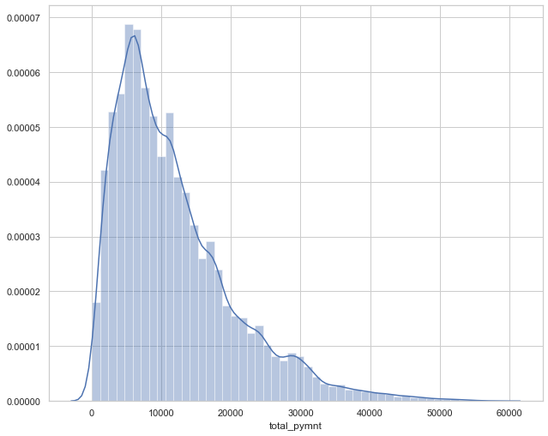
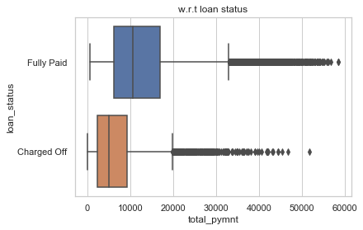
avg total payment for charged off loans is approximately half of the that of fully paid loans.

Slide 20
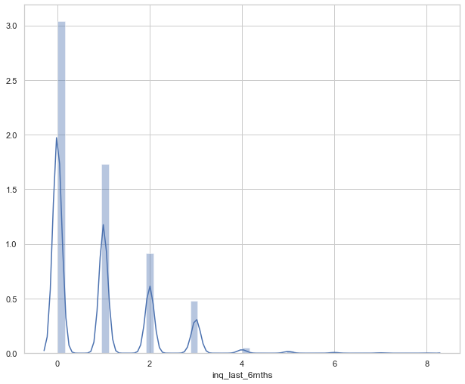
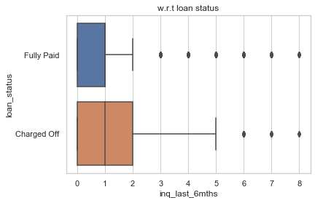
Enquiries in last 6 month
Clearly defaulter enquired more than paying

Slide 21
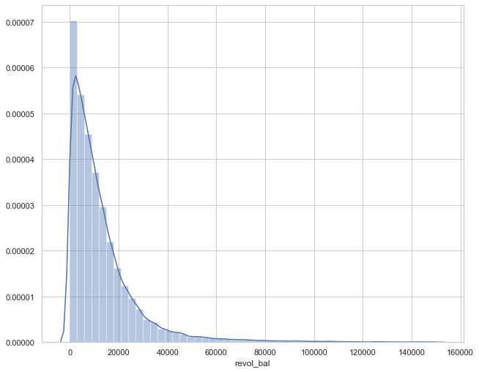
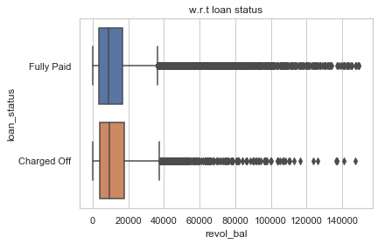
credit revolving balance

Slide 22
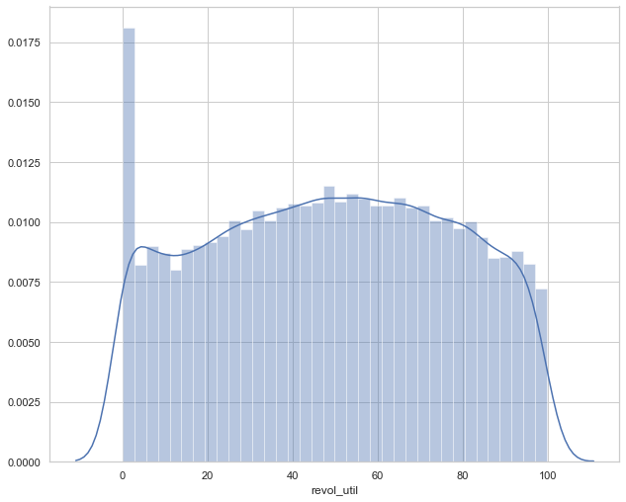
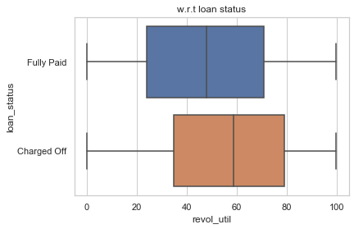
the amount of credit the borrower is using relative to all available revolving credit

Slide 23
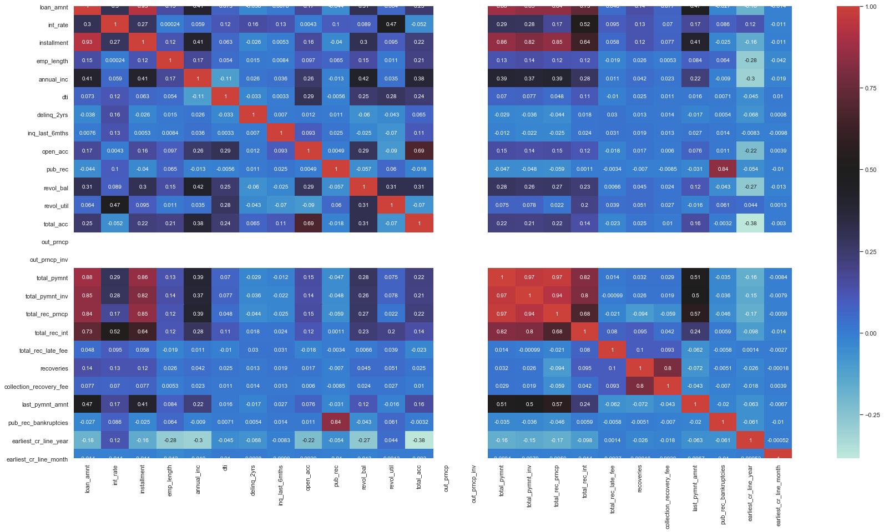
Correlation plot with all features

Slide 24
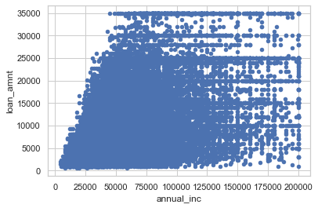
Annual income vs loan amount
mostly people asking for loan is lower income group for lower value loan

Slide 25
Inferences from EDA
People looking for loan from LC are usually looking for small loan amount
Majority of borrower are residing in rented or mortgaged home
More interest has more tendency to default. As for higher value loans more interest is charged by LC
It was observed that approximately 14.2% of people were charged off with 8.9% of total loaned amount
Grade A and Grade B are relatively lower in risk to provide loan
Defaulter enquired more than once in last 6 month
10k loan amount requested more it seems
5k is most given loan amount
Defaulter had slightly more installment amount
Maximum number of loans were distributed in theses states in order CA>NY>FL>TX
36 month term is most wanted loan term slab
Interest rates varies with maximum observation between 7 to 14 percent

